Slide 1
EMPLOYEE ATTRITION
A ‘Case’ Study
Tazeb Abera
December/2019

Slide 2
Introduction
Attrition in human resource is the gradual loss of employee over time.
it is a problem that impacts all business, irrespective of geography, industry and size of the company.
Changes in management style, company structure, or other aspects of the company might cause employees to leave the company voluntarily, resulting in a higher attrition rate.
Another possible cause of attrition is when a company eliminates a job completely..

Slide 3
Objective
This Case study try address issues concerning the attrition of an employee with respect to several paramters.
The main goal of the analysis is to study the indicators of attrition in order to identify ways that the company can improve employee retention to save money and time spent in hiring and training.

Slide 4
Data Quality Check
Data summary
Name | dataset
Number of rows | 870
Number of columns | 36
Column type frequency:
factor | 9
numeric | 27
Data Cleaning
Three Columns with no variability are dropped.
Drop Over18 as there is no variability, all are Y.
Drop EmployeeCount as there is no variability, all are 1.
Drop StandardHours as there is no variability, all are 80.
Missing variables are also assessed

Slide 5
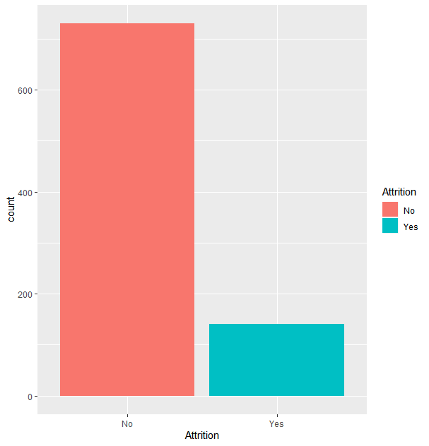
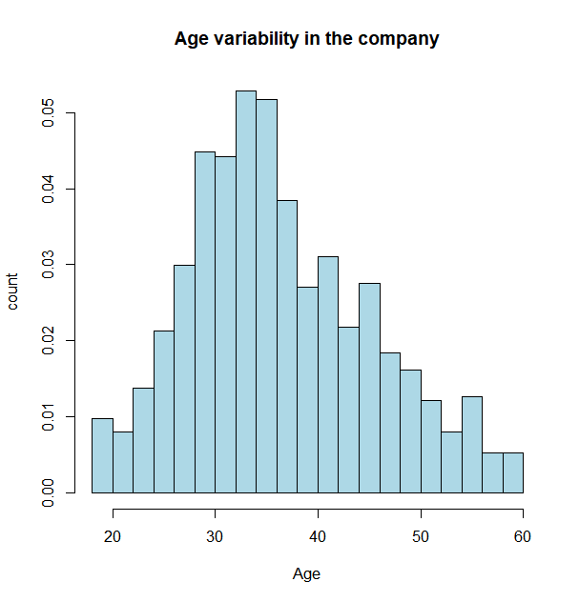
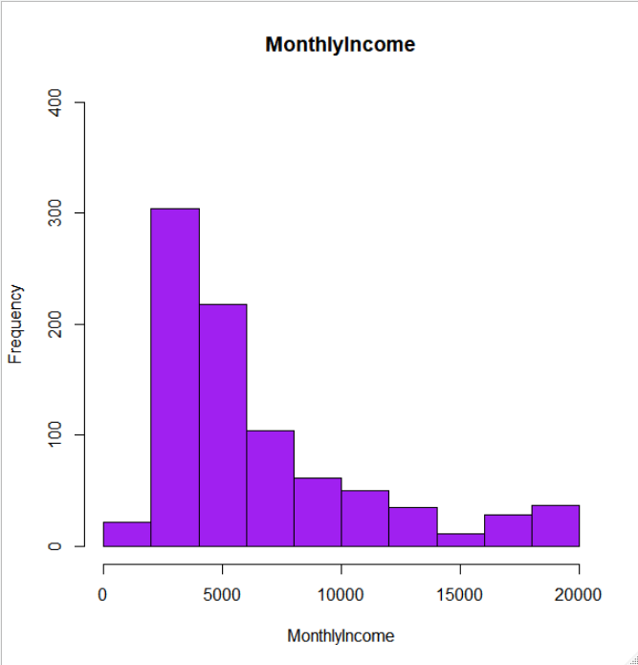
EDA and Data preparation

Slide 6
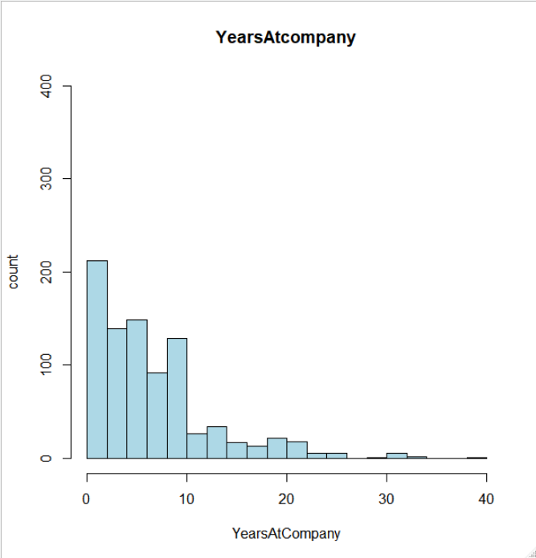

Slide 7
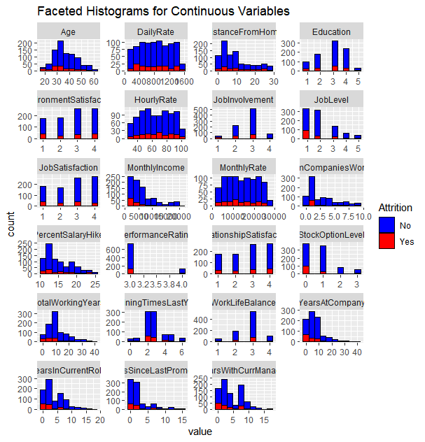

Slide 8
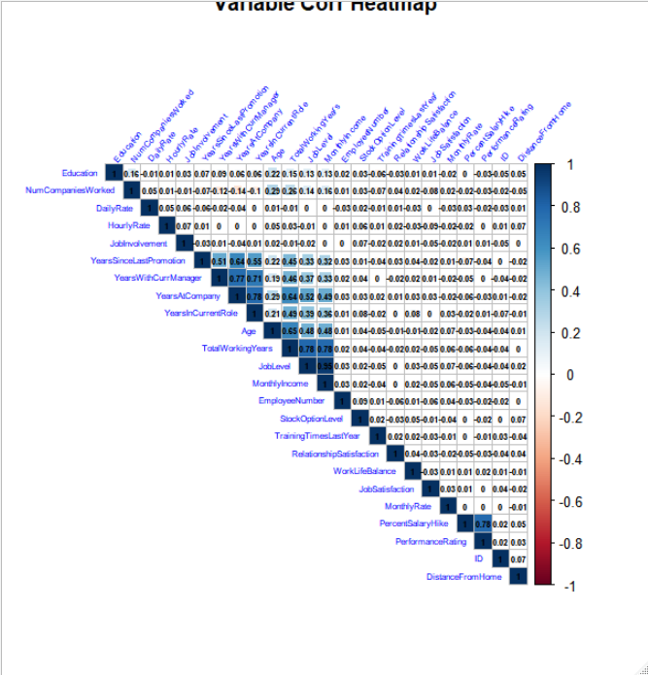
Correlation Matrix
High Correlation Results: having above 70% correlation
- MonthlyIncome vs. JobLevel (95.16% correlation)
- TotalWorkingYears vs. JobLevel (78.08% correlation)
- MonthlyIncome vs. TotalWorkingYears (77.85% correlation)
- YearsAtCompany vs. YearsInCurrentRole (77.61% correlation)
- YearsAtCompany vs. YearsWithCurrManager (76.52% correlation
- YearsWithCurrManager vs. YearsInCurrentRole (70.95% correlation)

Slide 9
Build Model
Classification prediction model and
Regression
-- Logistic regression
-- Random forest
are implemented in this project
These are the two supervised machine learning mechanisms

Slide 10
Conclusion

